Slide 1


UbiComp ‘16
Exploring User Experiences of Active Workstations
A Case Study of Under Desk Elliptical Trainers
Woohyeok Choi (woohyeok.choi@kaist.ac.kr), Aejin Song, Darren Edge*, Masaaki Fukumoto†, Uichin Lee
Korea Advanced Institute of Science and Technology, Daejeon, South Korea
*Microsoft Research Cambridge, Cambridge, United Kingdom
†Microsoft Research Asia, Beijing, China
Notes:
Thank you for nice introduction, Kristof.
Good afternoon. I’m Woohyeok, from KAIST.
Today, I’m gonna present the paper, “Exploring User Experiences of Active Workstations: A Case Study, of Under Desk Elliptical Trainers”
As the title says, this paper is about how people use active workstations and how they feel about it.
I hope that this presentation makes you interested in technology interventions for the workplace and active workstations.
Then, let me get started.

Slide 2





Physically Active Lifestyle
Non-exercise activity thermogenesis (NEAT)
Activity thermogenesis
Thermic effect of food
Sport-like exercise
activity
Basal
metabolic
rate
Notes:
The title of this session is, Supporting Physically Active Lifestyle.
Then, what is the Physically Active Lifestyle?
Human daily energy expenditure is comprised of three components:
(click)
Basal metabolic rate, which is basically consumed, regardless of physical activities
(click)
thermic effects of food, which is associated with food digestion,
(click), and activity thermogenesis, which is energy generation while performing any physical activity, like sitting, walking, running, jumping, or something like that.
In terms of this, Physically Active Lifestyle, would be a way of life, that activity thermogenesis remains high.
There are two types of activity thermogenesis.
(click)
The first one, sport-like exercise activity thermogenesis, is energy expenditure, while we take some purposeful exercises, like weight training or playing basketball.
(click)
And the other one, non-exercise activity thermogenesis, or NEAT, is energy expenditure of, all physical activities, other than purposeful exercise activities, like going up the stairs or taking a walk.
Thus, supporting physically active lifestyles can be achieved by two ways: encouraging purposeful exercise, or increasing NEAT
But as you know, many people do not exercise regularly, even if they know that, it is important. So, to achieve physically active lifestyle, we should more focus on how to increase NEAT.

Slide 3










Sedentary Work
Obesity
Cardiovascular problem
Diabetes
Notes:
The NEAT, greatly varies depending on a type of occupation, and it is significantly low in a modern office work style, like sitting on a chair and performing computer-related tasks.
For example, sedentary workers expend much less energy, than standing or agricultural workers.
The reason for low NEAT is obviously, prolonged inactivity and sedentariness.
(click)
Office workers spend 8.7 hours in the workplace, and they spend 6.7 hours sitting, during working hours.
(click)
As you know, sitting requires much less energy than other non-exercise physical activities, like standing and slow walking.
As a result, office workers expend significantly less energy than, other occupations.
(click)
Such prolonged inactivity and sedentariness,. make office workers exposed to, the risk of various disease, including obesity, diabetes, and cardiovascular dysfunction

Slide 4
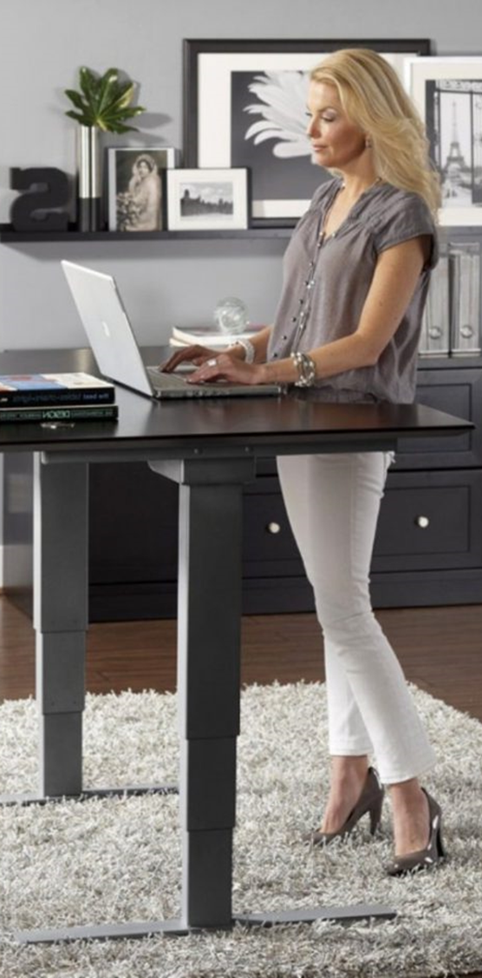
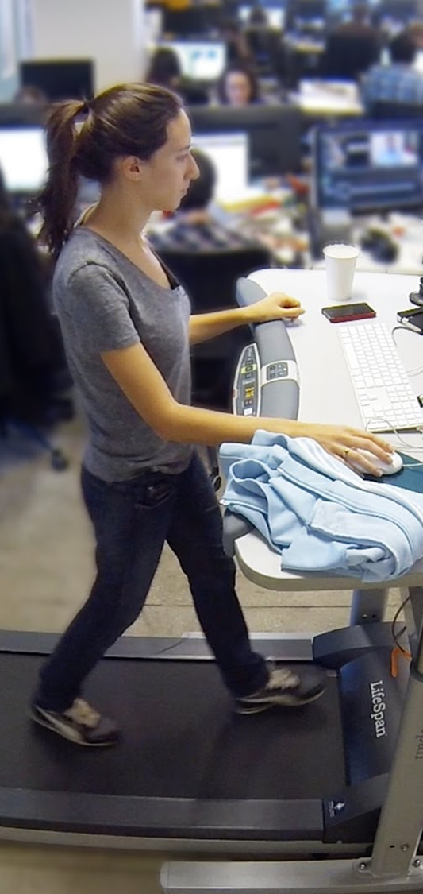
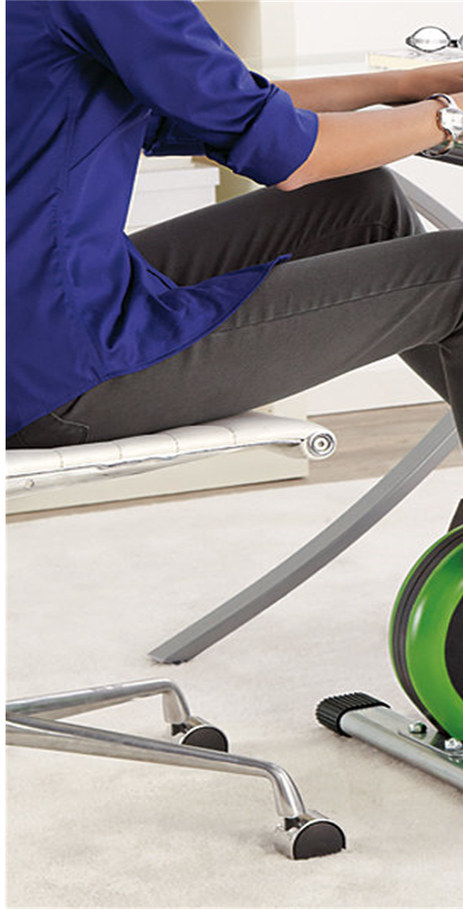
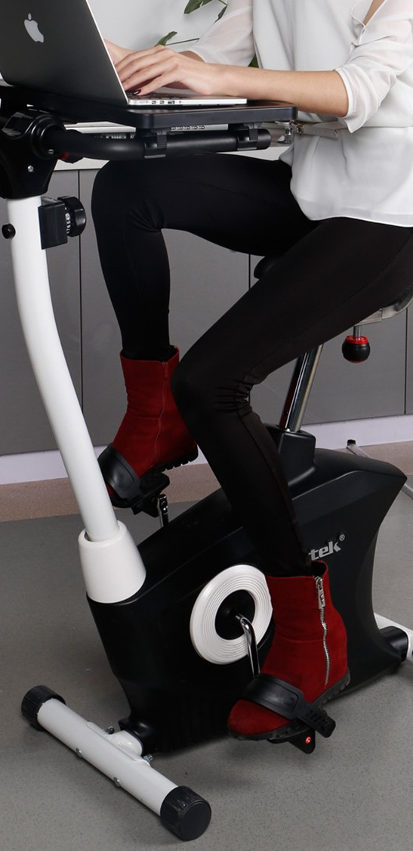
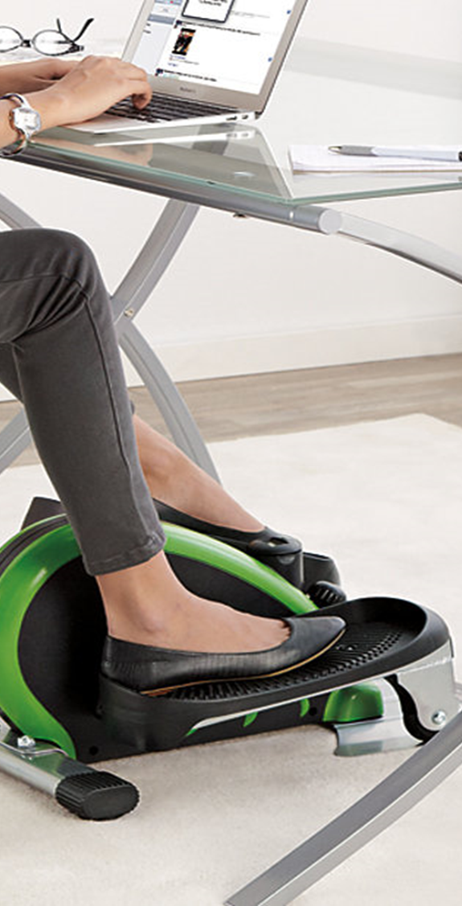



?
?
Active Workstation
Notes:
In order to prevent these disease and promote physical activity at work,
special office furniture, called active workstation, that, enables physical activities at work, has also gained popularity in recent years.
This furniture allows people to simultaneously perform office tasks while engaging in various physical activities, such as standing, walking, and pedaling.
(click)
Many researchers in medical and physiological fields, have been actively investigating, the effectiveness of active workstations on health, and their influence on work performance.
(click)
However, this new domain of research has so far been under-explored, in terms of the user experience.
So, this work mainly, aims to investigate, how office workers use active workstations, and how they feel about it.
(click)
Specifically, we employed elliptical trainers, as a target active workstations due to their cheaper price and smaller size than other active workstations.
Let me go to details.

Slide 5
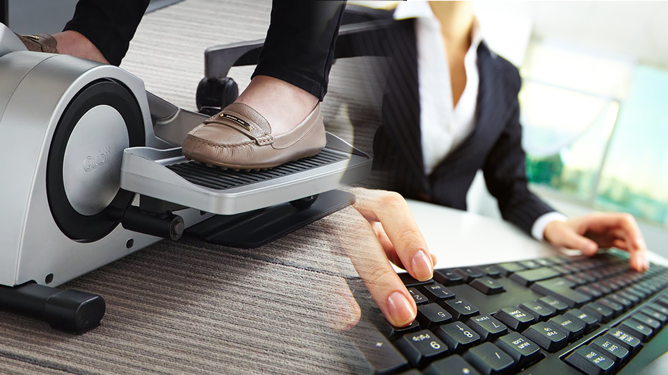
What is the influence of
an elliptical trainer
on task performance?
Notes:
As I said, active workstations enable, office workers to perform, various physical activities in the workplace.
But, let’s think about it.
Performing two different things?
Is it fine, in terms of work performance?
Before we adopt desk elliptical trainers in the workplace, we should check whether, they have negative influences on work performance.
The first question is, what is the influence of an elliptical trainer on office task performance?

Slide 6
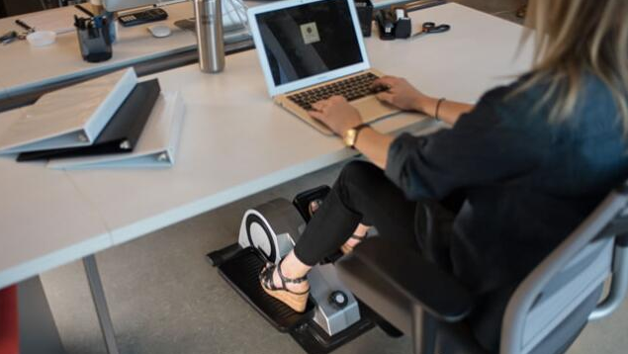
How and why
do office workers use
elliptical trainers at work?
Notes:
Next, if the use of elliptical trainers, has some effects on task performance, we should mitigate negative ones.
For this, we should practically understand, contexts and purpose, for the use of elliptical trainers.
The second questions is, how and why do office workers use elliptical trainers at work.

Slide 7

How do office workers
feel about
the use of elliptical trainers at work?
Notes:
Finally, to encourage office workers, to use elliptical trainers at work, it should be investigated, something good or something bad about the use of elliptical trainers.
So, the third questions is, how do office workers feel about the use of elliptical trainers at work.

Slide 8

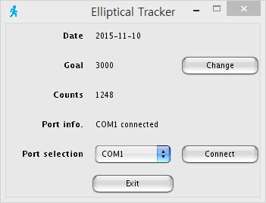





Study Procedure
13 Participants (age: 24-33)
/ 8.7 hours of sedentary work
4-week deployment with
weekly surveys / usage tracking
1:1 interviews
Performance measurements
of simulated office tasks
Performance measurements
of simulated office tasks
Notes:
To this end, we performed a 4-week experiment with thirteen graduate students, who mainly engage in sedentary work.
(click)
To investigate influence on work, we measured the performance of different office tasks, comparing two cases that, elliptical trainers are concurrently used or not.
(click)
We then installed elliptical trainers in each participant’s office for 4 weeks, and tracked how many steps they take, using an elliptical trainer.
(click)
Also, we asked them to perform, at least 3,000 strides as a daily goal, and gave self-monitoring tools that, show usage information.
Each participant responded to weekly surveys, which evaluate user experiences, in relation to both work and exercise aspects.
(click)
After the end of 4-week deployment, we again, measured office task performance, and
(click)
conducted one-on-one exit interviews.
Then, I’ll give you the more detailed explanations, of experiment processes and the results.

Slide 9
Influence on Work
How does the use of an elliptical trainer
influence on the performance of office tasks?
Task Descriptions
Experiment Setup
Performance Comparison
Notes:
The first one is influence on work performance, owing to the use of elliptical trainers.

Slide 10


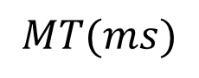
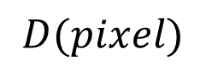
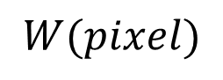
Mouse Pointing
$$W(pixel)$$
$$D(pixel)$$
$$MT(ms)$$
$$TP=\log_{2}{(D/W_{e}}+1)/MT$$
Notes:
We chose three simulated office tasks, like mouse pointing, keyboard typing, and selective attention.
To measure mouse pointing performance, we adapted single-direction pointing task, in which a participant
(click)
alternatively points and clicks two rectangles, a certain distance apart.
(click)
Taking into account movement time, accuracy, and pointing difficulty,
(click)
we assessed throughput in bps, which is ISO standard measure for performance of pointing devices.

Slide 11



Keyboard Typing
The Gettysburg Address
Four score and seven years ago our fathers brought forth on this contttinent, a new nation, conceived in Liberty, and dedicated to the proposition that all men are created equal. Now we are engggaged in a great civil war…
$$EW$$
$$WPM$$
$$NWPM=WPM−EW$$
Notes:
For the keyboard typing performance, we asked participants, to transcript Gettysburg address for one minute, and measured
(click)
words per minute, and
(click)
the number of error words.
Using these two measures, we calculated,
(click)
net words per minute, which is defined as subtraction of the number of error words from words per minute.

Slide 12


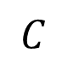
Selective Attention
Word Phase
Color Phase
Color-Word Phase
RED
RED
BLUE
RED
XXXX
RED
$$W$$
$$C$$
$$CW$$
$$I_{D}=CW−(W×C)/(W+C)$$
Notes:
To assess selective attention, we adapted Stroop Color-Word test, which has been, widely employed to, measure psychological capacities in neuropsychology.
This test is comprised of three different tests.
(click)
At the first time, participants identify, names of colors, which are colored in black.
(click)
Then, they identify, the colors of arbitrary symbols, which are colored in different colors.
(click)
For the final test, they identify, the color of color words, which are filled with an. incongruent color, like the word RED, but colored in BLUE.
(click)
We collected the number of identified words in each test, and
(click)
calculated difference score, which indicates, capacity of selective attention.

Slide 13





Experiment Setup
X 5
4-week
deployment
X 5
Before deployment
After deployment
Notes:
Each task is performed in, both pedaling and non-pedaling conditions,
and each pair of task types and pedaling, is conducted five times.
(click)
And as I previously mentioned, this measurement was performed again after 4-week deployment.

Slide 14
Performance Comparisons
Mouse pointing
Keyboard typing
Selective attention
p=0.001, d=1.195
Before
Only < 8% differences!?
After
Notes:
From our paired T-test analysis,
(click)
only mouse pointing performance showed, statistically significant difference, in a before-deployment condition.
But, this difference, became non-significant after 4-week deployment.
Keyboard typing and selective attention did not show any significant performance difference.
(click)
In addition, all the measurement pairs show very small difference, at most 8%.

Slide 15
In Summary,
The concurrent use of desk elliptical trainers results in
minimal impact on work performance.
So, we expected that office workers would use elliptical trainers without any work-related concern…
Notes:
Therefore, we would conclude that, the concurrent use of desk elliptical trainers, results in
(click)
minimal impact on work performance.
At this stage, we expected that, office workers would use elliptical trainers
(click)
without any work-related concern, because, it does not show any significant performance degradation.
But, is this expectation true?
Let me go to how office workers actually use elliptical trainers.

Slide 16
Usage Contexts
How and why do office workers
use elliptical trainers at work?
Usage Statistics
Temporal Contexts of the Use
Purposes of the Use
Notes:
From this, I’ll show you the results of our 4-week deployment study, in terms of how and why office workers use elliptical trainers at work.

Slide 17
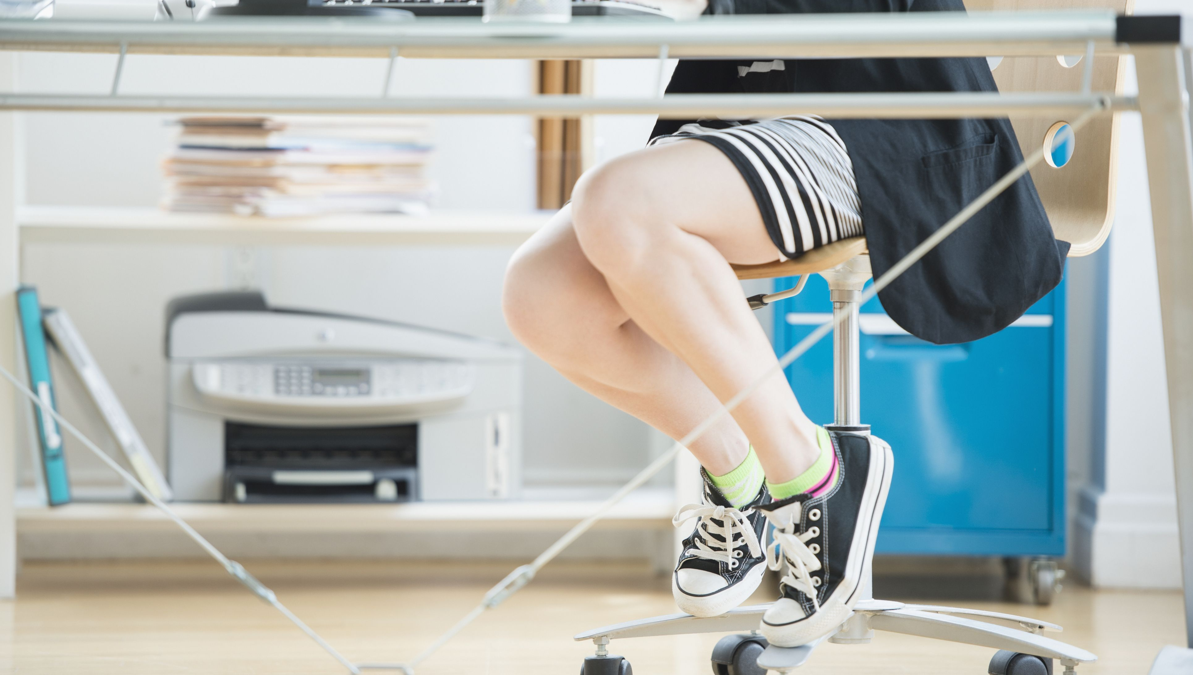
Usage Statistics
2,691strides taken 38.4 minutes of use
with an elliptical trainer
Why did they use elliptical trainers only for a limited amount of time?
5 participants failed to meet
the daily goal of 3,000 strides per day
Notes:
Although we gave a daily goal, in order to encourage to use elliptical trainers, they took smaller strides than the daily goal,
And they use elliptical trainers for a short time, such as 38 minutes per day.
(click)
In addition, on a daily average, five participants, failed to meet the 3,000 strides.
According to the result of, performance measurements, we expected participants to actively use elliptical trainers. But, it is not.
(click)
Why? Why did they use elliptical trainers, only for a limited amount of time?

Slide 18

When they use
“
I pedaled this machine while surfing the web or watching sports videos on YouTube during a rest [...] However, it was difficult to comprehend a novel or an unfamiliar paper while using this machine. [p11]
I pedaled this machine while surfing the web or watching sports videos on YouTube during a rest [...] However, it was difficult to comprehend a novel or an unfamiliar paper while using this machine. [p11]
”
Selective use depending on
perceived cognitive load
Notes:
From the result of exit-interviews, elliptical trainers were used, only when they
(click)
performed simple and trivial tasks, or took a rest.
(click)
In other words, they selectively used elliptical trainers, depending on the perceived cognitive load, of primary tasks

Slide 19

When they use
“
Since I use this machine in the office, I felt uncomfortable, because someone noticed the pedaling motion and noise. [p8]
Since I use this machine in the office, I felt uncomfortable, because someone noticed the pedaling motion and noise. [p8]
”
Selective use depending on
social environment
Notes:
In addition, because their offices were shared by other people,
(click)
they worried about, noise or how other people, looked at them.
(click)
So, our participants, did not use elliptical trainers, when there were other colleagues in their offices.

Slide 20
Why they use
“
After eating a meal, I felt sleepy and could not concentrate on work, so I used the machine to stay awake. [p8]
After completing a portion of work, I wanted to relax myself. Then, I used this machine. [p10]
After eating a meal, I felt sleepy and could not concentrate on work, so I used the machine to stay awake. [p8]
After completing a portion of work, I wanted to relax myself. Then, I used this machine. [p10]
”
Mental refreshment
Notes:
Then, what’s the purpose, for the use of elliptical trainers?
Main reasons were
(click)
to stay awake after meals, and to relieve their stress.
(click)
This type of usage purpose is mental refreshment.

Slide 21
Why they use
“
Usually, I pedaled this machine hard in short bursts [...] For the effect of exercise, it may be better to intensively use the machine. [p10]
Usually, I pedaled this machine hard in short bursts [...] For the effect of exercise, it may be better to intensively use the machine. [p10]
”
Workout
using an elliptical trainer
Notes:
Five participants, treated elliptical trainers, as exercise equipment,
(click)
so they, intensively used elliptical trainers in their free time.
(click)
In other words, they used elliptical trainers for workout.

Slide 22
Why they use
“
I placed my feet on the pedals almost all day. [...] Unlike fast
pedaling for exercise, I unknowingly pedaled. [p8]
I have a habit of shaking my legs, but placing my foot on the pedals changed this habit into pedaling. [p4]
I placed my feet on the pedals almost all day. [...] Unlike fast
pedaling for exercise, I unknowingly pedaled. [p8]
I have a habit of shaking my legs, but placing my foot on the pedals changed this habit into pedaling. [p4]
”
Footrests and fidgeting
Notes:
Also, because, they usually placed their feet, on the pedals.
(click)
they used elliptical trainers as footrests.
(click)
This type of usage, brought interesting habits, like, mindlessly pedaling the machine, instead of shaking their legs. or tapping their feet.

Slide 23
In Summary,
Participants selectively use elliptical trainers depending on cognitive load of their primary tasks, in spite of minimal impact of elliptical trainers on task performance.
Elliptical trainers are used for the purpose of workout,
as well as mental refreshment and footrests.
Notes:
In summary, our deployment study showed that elliptical trainers were
(click)
selectively used, depending on
(click)
Cognitive load, of their primary task.
(click)
Also, our participants used elliptical trainers, for the purpose of workout, mental refreshment, and footrests.

Slide 24
Feeling about it
How do office workers feel about
the use of an elliptical trainer at work?
Intrinsic Motivation
Task Load
Perceived Exertion
Office as Exercise Environment
Notes:
Ok, then, how did our participants feel about the use of elliptical trainers in the workplace?
Let me show the results, of questionnaires and exit-interviews.

Slide 25
Intrinsic Motivation
Positive predictor
“
At an early time, I was interested in this machine [...] As time went by, this machine became dull to me, and the exercise intensity was not enough. [p4]
Negative predictor
”
Notes:
The first thing is about motivation.
As you see,
(click)
positive motivational predictors, like interest and usefulness, were reasonably positive during 4 weeks.
(click)
However, these positive predictors, decreased over time.
In other words, our participants became, less motivated to use elliptical trainers.
Our interview results, explain the reason of it.
(click)
At an early time, participants thought like, “ok, an elliptical trainer seems to be good for health, I like it”
But, as time goes on, such expectation, and novelty effect, was gone off, because elliptical trainers, did not give enough exercise intensity, as they expected.

Slide 26
Task Load
“
The use of this machine seems like a mission to meet a daily goal, not exercise [...] I should spend time to achieve 3,000 strides. [p7]
”
Notes:
In terms of sources of task load,
(click)
Two different sources, like mental and temporal demand, remained high, and increased over time.
(click)
The reason of such high load, is the existence of daily goals.
They said, “The use of elliptical trainers, seems like a mission to meet a daily goal, not exercise.” And “I should spend time to achieve 3,000 strides.”

Slide 27
Perceived Exertion
“
Even if the use of the active workstation may burn calories a little bit, only doing this is not enough for fitness. [p7]
”
Light intensity workout
(9: very light / 11: light)
Notes:
In terms of perceived exertion,
(click)
the pedaling elliptical trainers was, a light-intensity workout, even if exertion level decreased over time.
(click)
All participants agreed that. the use of elliptical trainers at work cannot provide a substitute, for conventional exercises, mainly because of, its low intensity.

Slide 28
Exercise Settings of Workplace
“
The best advantage of exercise at work is that I can exercise everyday regardless of bad weather conditions. [p8]
As I stayed in the office, I regarded exercise at work as
a part of office activities. [p13]
”
Notes:
Our participants, were moderately satisfied, the exercise environments in the workplace.
(click)
The positive aspects were, availability, like no need to concern weather conditions, sportswear, time, and a certain location.
Just, they need to put up their feet, and rotate pedals.
(click)
But, this type of workout, was less refreshing than outdoor workout, and seems like another office task, because, it was performed in the workplace.

Slide 29
In Summary,
Participants were positively motivated to use the elliptical trainer, even though the motivation slightly decreased and task load somewhat increased over time.
Elliptical workout gave light intensity of exertion, and there was both pros and cons of using the workplace as an exercise setting.
Notes:
To summarize,
Our participants were
(click)
positively motivated the elliptical trainers at work, even if, there was slight decrease in motivation, and increase in task load.
(click)
Workout using elliptical trainers provided light intensity of exertion.

Slide 30



Implications
Selective health intervention depending on work contexts
Interactions
through
active workstations
Notes:
From our results, we discuss several design implications.
As a first thing, when we design, health intervention in the workplace, we should consider work contexts.
Our results showed that, workout is selectively performed, depending on cognitive load of primary tasks and social aspects.
To encourage office workers participate in health intervention, such things should be carefully considered.
(click)
Second one is interaction through active workstations.
In case of elliptical trainers, participants used them as footrests.
In other words, elliptical trainers, were physically in contact, with body parts, and this is similar, in other active workstations.
Such physical contact, would provide new opportunities for interaction technique, like mechanical nudging, to trigger, mindless fidgeting, or controlling, desktop environments using active workstations.

Slide 31
Summary
Through our explorative study on under desk elliptical trainers and their user experiences,
The use of elliptical trainers has a minimal impact on work performance, but,
Decision of exercise during working hours mainly depends on the perceived cognitive loads of primary tasks.
There are positive usage motivations, but it should be mitigated motivation drop and practical problems (e.g., noise)
Notes:
This is overall summary, and that’s all for my presentation. Thanks for listening.
And, please feel free to ask me, if you have any questions at all.

Slide 32
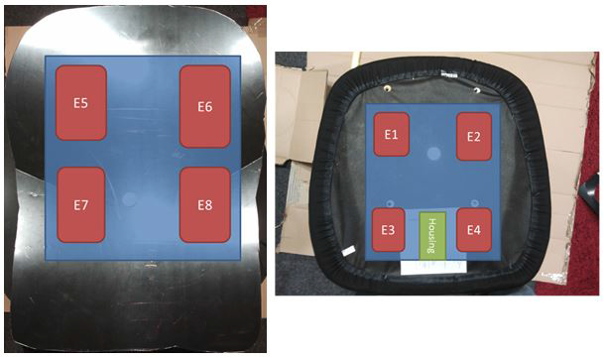
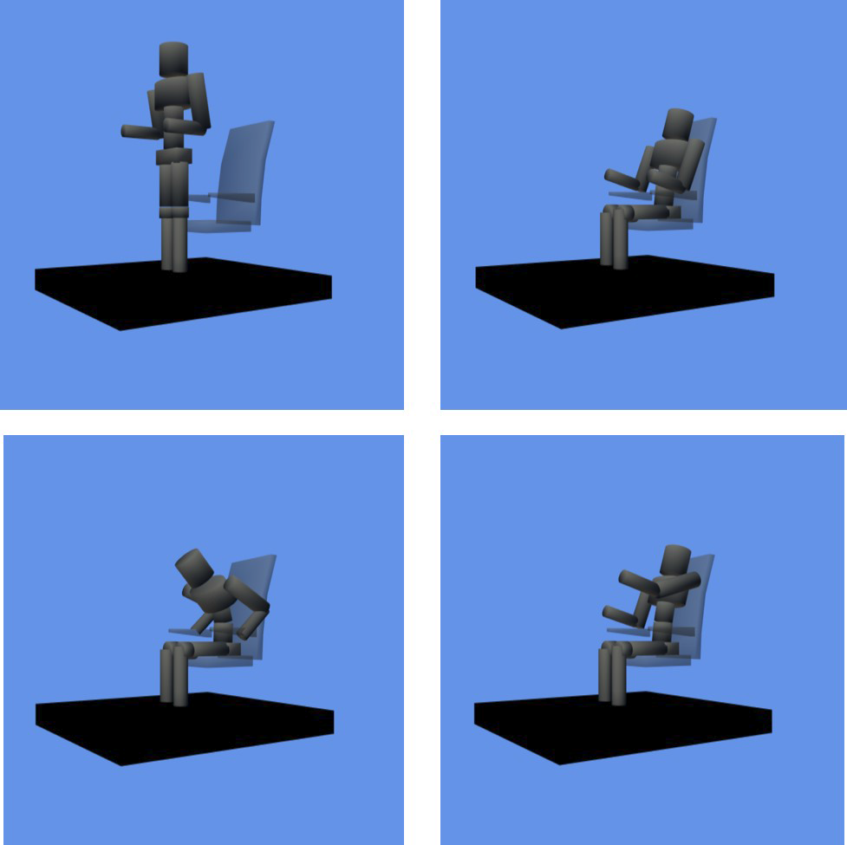
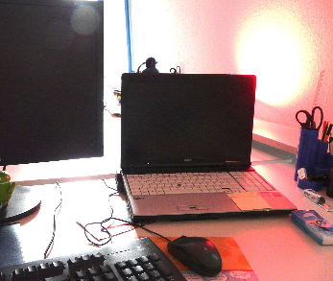
Health Intervention at Work
Reduce sedentary time
Through office appliances
Detecting prolonged sedentariness / taking a simple workout
Deliver awareness of a level of physical activities through office appliances
Notes:
In order to prevent these disease and support physically active lifestyle, conventional sedentary work style, should be changed.
For example, we would prompt, office workers to take a break, or a simple workout, when they sit for a long time.
(click)
Or, we can deliver awareness information, regarding a level of physical activities, like daily step counts, through the office accessories or appliances, like a desk lamp.

